Slide 1
Bio& 242:
Unit 2 / Lab 3

Slide 2
Histology Slides for the
Respiratory System
Slides are presented in order of magnification
As you view the following slides make sure you can accomplish these goals:
Can you identify the organ or duct from which the tissue sample was taken?
Can you identify the specific structures or layers indicated by the numbered arrows or brackets?
At the end of a sequence, you will find the answers to the above for each organ or duct

Slide 3
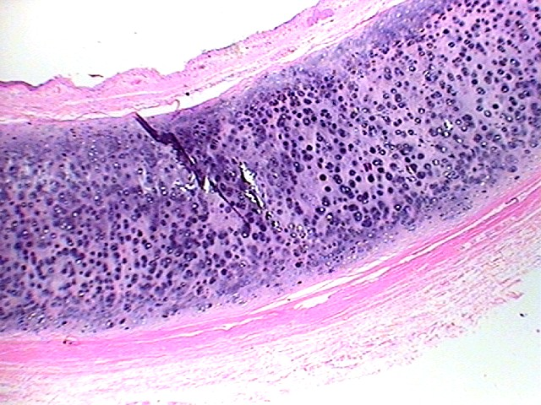
1
4
2
3
5
6
Organ? 40X

Slide 4
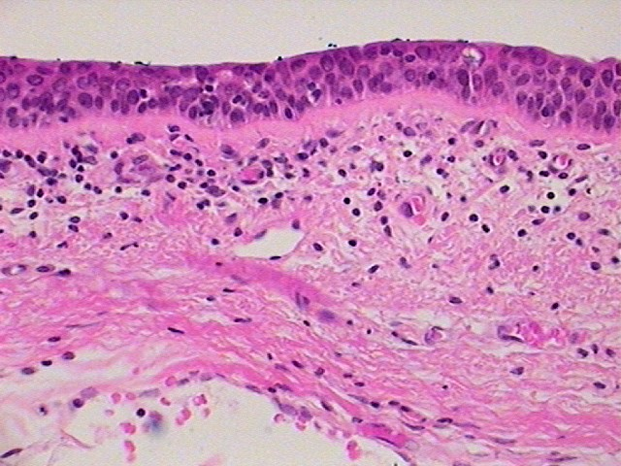
1
2
3
4
Organ? 400X

Slide 5
Tissue from Trachea slides 2-3
Slide # 2: Trachea (40X)
1. Lumen of the trachea
2. Epithelium of the Trachea
3. Submucosa
4. Seromucous Gland
5. Hyaline Cartilage
6. Adventitia
Slide # 3: Trachea (400X)
1. Lumen
2. Pseudostratified Ciliated Columnar Epithelium (Cilia not seen)
3. Lamina Propria
4. Submucosa

Slide 6
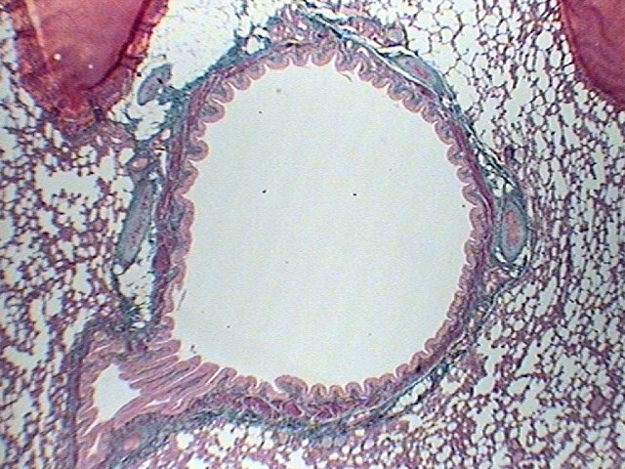
7
3
1
5
2
8
4
6
Organ? 40X

Slide 7
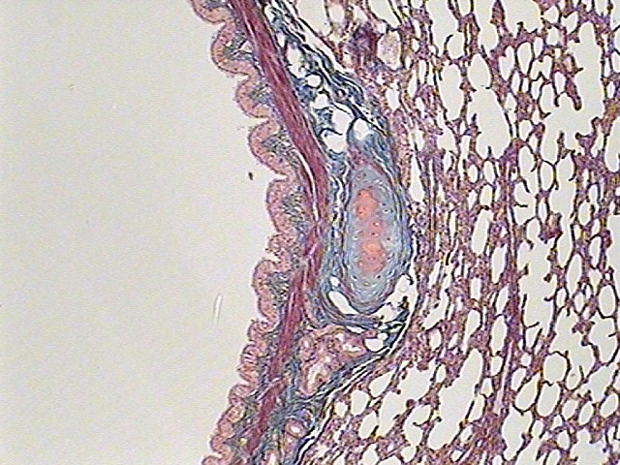
2
8
6
1
5
7
4
3
Organ? 100X

Slide 8
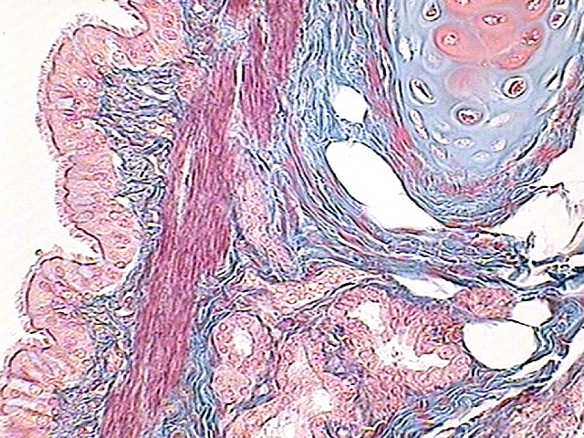
2
5
3
1
6
7
4
Organ? 400X

Slide 9
Tissue from Tertiary Bronchi slides 5-7
Slide # 5: Tertiary Bronchi with Lung tissue (40X)
1. Lumen
2. Epithelium of the Tertiary Bronchi
3. Lamina Propria
4. Seromucous Gland
5. Hyaline Cartilage
6. Smooth Muscle
7. Blood Vessel
8. Lung Tissue

Slide 10
Tissue from Tertiary Bronchi slides 5-7
Slide # 6: Tertiary Bronchi with Lung tissue (40X)
1. Lumen
2. Epithelium of the Tertiary Bronchi
3. Lamina Propria
4. Seromucous Gland
5. Hyaline Cartilage
6. Smooth Muscle
7. Submucosa
8. Lung Tissue

Slide 11
Tissue from Tertiary Bronchi slides 5-7
Slide # 7: Tertiary Bronchi with Lung tissue (400X)
1. Lumen
2. Pseudostratified Ciliated Columnar Epithelium
3. Lamina Propria
4. Seromucous Gland
5. Hyaline Cartilage
6. Smooth Muscle
7. Submucosa

Slide 12
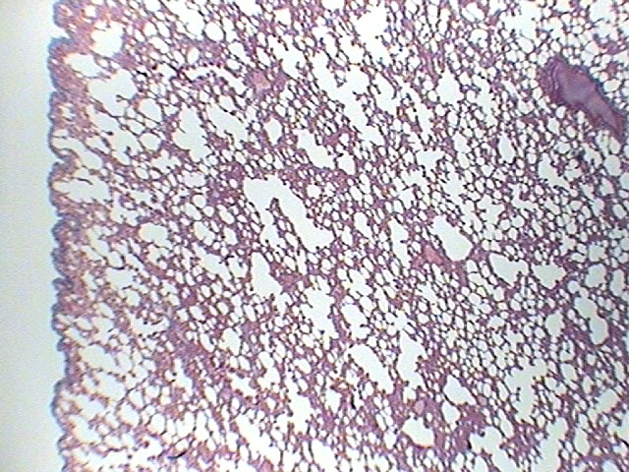
2
3
1
5
4
Organ? 40X

Slide 13
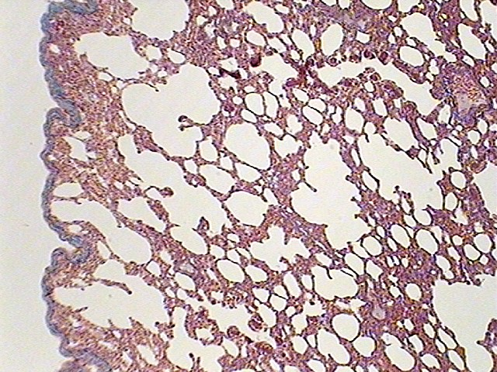
2
5
3
1
4
Organ? 100X

Slide 14
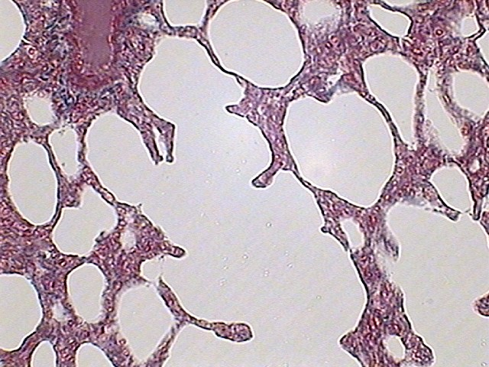
3
2
1
Organ? 400X

Slide 15
Tissue from Lung slides 11-13
Slide # 11: Lung (40X)
1. Visceral pleura
2. Respiratory bronchiole
3. Alveolar duct
4. Alveolar sac
5. Alveolus
Slide # 12: Trachea (100X)
1. Visceral pleura
2. Respiratory bronchiole
3. Alveolar duct
4. Alveolar sac
5. Alveolus

Slide 16
Tissue from Lung slides 11-13
Slide # 13: Lung (40X)
1. Alveolar sac
2. Alveolus
3. Blood Vessel

